Slide 1

An Introduction to LLMs and AI Ethics:
Balancing Innovation with Integrity
Tacksoo Im

Slide 2

About Instructor
Professor of Information Technology at Georgia Gwinnett College in Metro Atlanta
15 years experience teaching Information Technology including software development and artificial intelligence
Clemson Grad. Go tigers!
Slides created and enhanced with help of AI (including image on the left)

Slide 3






Agenda
1. What Are Large Language Models?
2. How and why should we use LLMs in Business?
3. The Ethical Landscape
Understanding the critical risks and our responsibilities.
A brief introduction to the technology and its core concepts.
Exploring practical applications and opportunities for innovation.

Slide 4
Tools and Slides
Prompt Helper
https://tacksoo.github.io/prompt-helper/
Link to Slides
https://github.com/tacksoo/prompt-helper

Slide 5
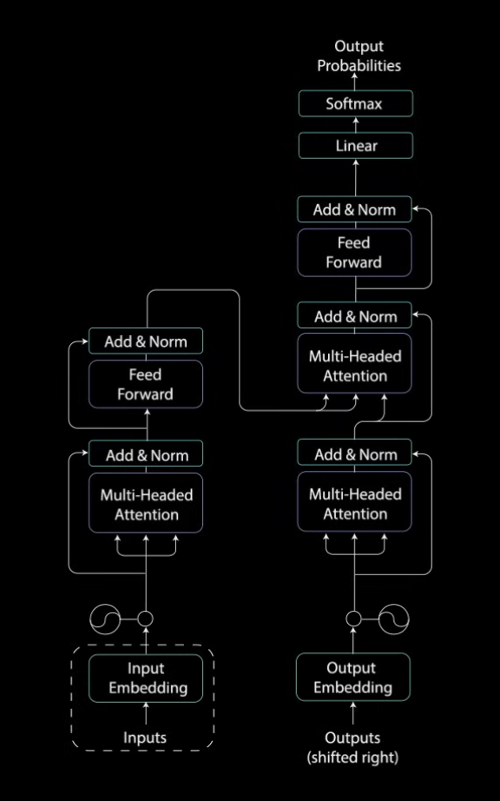
What is a Large Language Model (LLM)?
A system that infers (predicts) the most likely word (token) based on learned patterns
As of 2025, frontier models such as GPT-5, Gemini 3, Claude 3.5 Opus, cost hundreds of millions to train and are capable of the following:
General Intelligence – reasoning, planning, flexible problem solving
Multimodal reasoning and data analysis
Coding and software development
Take on creative and collaborative roles
Notes:
Image taken from https://www.youtube.com/watch?v=4Bdc55j80l8
Amazing but also criticized my many brillant folks such as Noam Chomsky

Slide 6
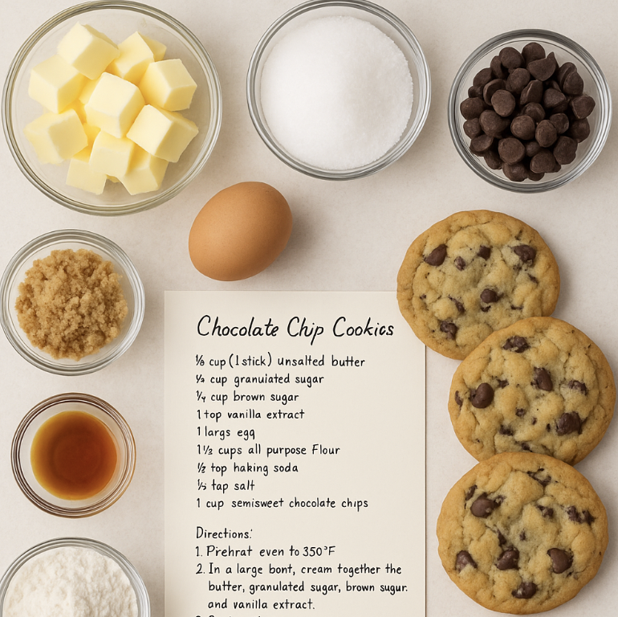
How does inference work?
Frontier Models
GPT-5, Gemini 3 Pro, Claude Opus, DeepSeek 3.2, Grok-4
2. Training Data
4. Output (Response)
LLMs work by statistically predicting the next most likely
word in a sequence based on the patterns they learned during training.
Generates a coherent, human-like answer word by word.
1. Input (Prompt)
3. Prediction
User provides a question or a command.
Calculates the most statistically probable next word.
Notes:
As of 2025, data centers can cost up to 100 billion (OpenAI Stargate) in Texas and training a model and cost up to $100 million (or more)
https://www.visualcapitalist.com/the-surging-cost-of-training-ai-models/

Slide 7
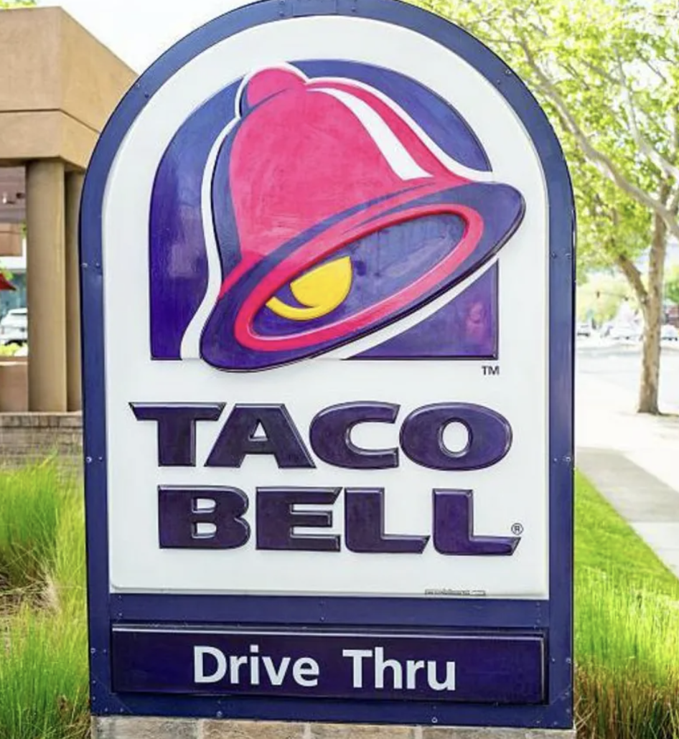
Why use LLMs?
The Innovator’s Dilemma (Clayton Christensen 1997)
Not an easy choice. Called a dilemma because there's no easy answer: ignore disruptive innovations and risk obsolescence, or chase small unprofitable markets and upset your shareholders and best customers
5% Wins with LLMs
CarMax automates customer service triage
Sanofi reduces compliance errors
Colgate-Palmolive automates routine tasks (data entry, scheduling, vendor management)
Unilever improves customer retention with targeted campaigns
Notes:
So far, practical tools for enhancing productivity rather than revolutionary or sentient entities. Richard Stallman famously says it should not be called AI as it cannot “know or understand” anything.
https://mitsloan.mit.edu/ideas-made-to-matter/practical-ai-implementation-success-stories-mit-sloan-management-review
https://www.bbc.com/news/articles/ckgyk2p55g8o

Slide 8
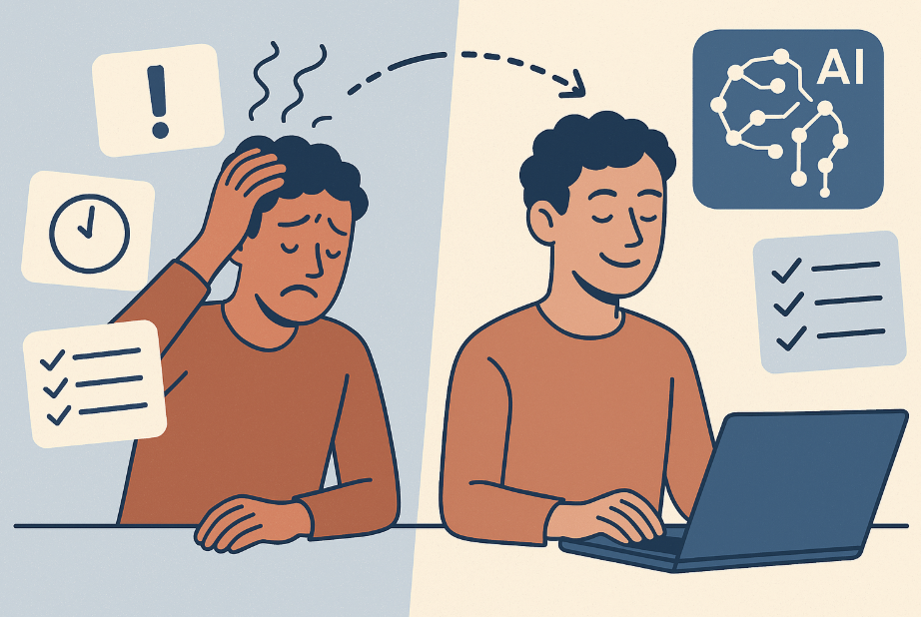
Where can these apply this tools?
Most successful applications of these tools focus on using them as assistants to improve productivity and help accomplish more.
Learning, Research, and Planning
Generating ideas and finding related works
Setting up a draft plan
Visualization and Pattern finding
Generate drawing and figures
Look for errors and inconsistencies
Basic Diagnostics
Ask it to diagnose something
Content Summary and Translation
Tool to help you write
Expand to foreign markets
Various other tasks
Responding to upset customers
Automate social media posting
Notes:
77% of Americans reported being stressed at work, maybe AI can help
https://www.selectsoftwarereviews.com/blog/workplace-stress-statistics
https://www.newsweek.com/us-worker-burnout-reaches-six-year-high-10862388

Slide 9
Prompting Terminology
Prompt – The text you feed the model
Token – The unit LLMs actually “read” (~4 characters or ¾ of a word)
Context Window – How many tokens the model can handle at once
System Prompt – The hidden instructions that define the model’s personality/rules
Few-Shot – Giving a few examples in the prompt to teach the model
Chain of Thought (CoT) – Telling the model to “think step by step”
Temperature – Controls randomness (0 = safe/boring, 1+ = creative/wild)
Hallucination – When the model confidently makes stuff up
RAG (Retrieval-Augmented Generation) – Adding real documents/data to the prompt
Agent – An LLM that can use tools, loop, and act autonomously

Slide 10
Does prompting matter? Yes!
Be ridiculously specific
Assign a strong role/persona up front
Use Chain-of-Thought by default for anything complex
Give the desired output format explicitly
Use few-shot examples (2–4) for any non-trivial or stylistic task
Iterate: treat the first response as a draft
Notes:
Be ridiculously specific Never say “make it better.” Say exactly what you want: tone, length, structure, audience, format, constraints, and examples of what “good” looks like.
Assign a strong role/persona up front Start with: “You are an expert [role] with 15 years of experience who explains things clearly and never uses fluff.” This single line often doubles output quality.
Use Chain-of-Thought by default for anything complex Add “Think step by step” or Let’s think step by step” to every reasoning, math, planning, or debugging prompt. It’s the single biggest free performance boost.
Give the desired output format explicitly Pros never leave formatting to chance. Use markdown, bullet points, JSON, tables, or literal examples: “Respond in the following format”
Use few-shot examples (2–4) for any non-trivial or stylistic task One perfect example is worth 500 words of instruction. Copy-paste real input → desired output pairs before your actual request.
Iterate: treat the first response as a draft Top prompt engineers almost never accept the first output. They immediately reply with: “Great start. Now improve it by doing X, Y, Z” or “Make it 30% shorter and twice as punchy.” Refining beats rewriting from scratch every time.

Slide 11
Part 2: The Ethical Landscape
Navigating the Risks and Responsibilities of AI

Slide 12
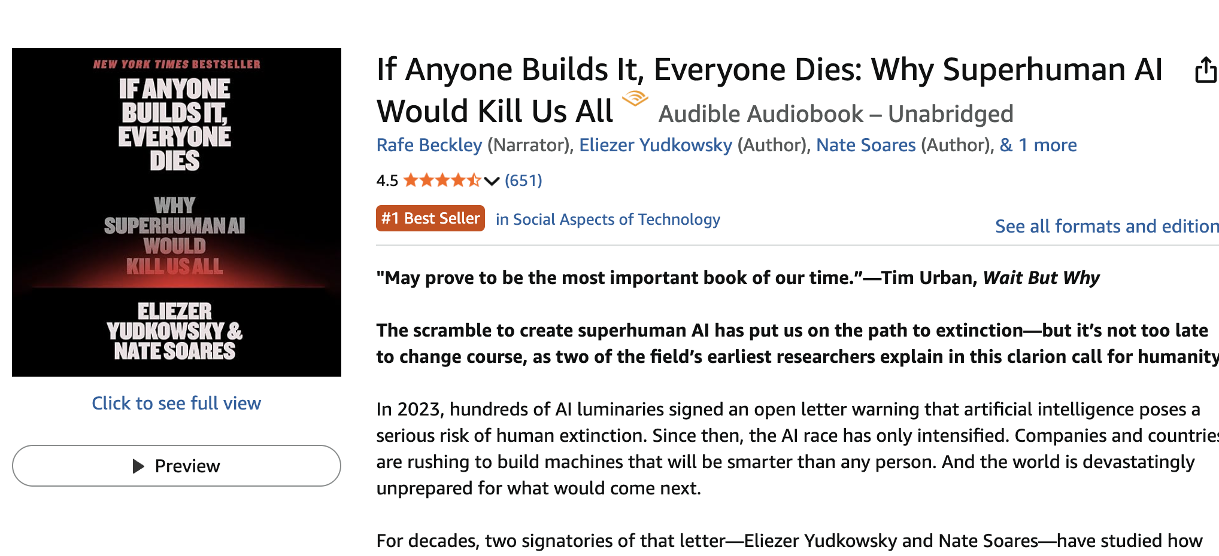
Ethics 1: Transparency & Explainability
Ethics 2: Fairness and Non-discrimination
Ethics 3: Accountability and Privacy
Ethics 4: Safety & Human Control
Ethics 5: Sustainability

Slide 13
EU AI Act (2024–2026 rollout)
Risk based approach: prohibits unacceptable AI risk
Transparency and human in the Loop: AI is a co-pilot, not the pilot. You are ultimately responsible and accountable for the final output.
Scrutinize for Bias: Critically review outputs for fairness, stereotypes, and biased language before use.
Verify, Don't Trust: Fact-check all data, sources, and critical claims. Assume all outputs are a draft, not a fact.

Slide 14
Part 3: Prompting Exercises

Slide 15
Specificity
Vague prompt: 'Write about productivity’
Review the generic output as a group
Guide participants to add:
• Specific context (who is this for?)
• Clear constraints (length, format)
• Desired tone and style
Notes:
Example refined prompt: 'Write a 200-word email to my remote team suggesting three evidence-based productivity techniques, with a friendly but professional tone'
Compare outputs and discuss improvements

Slide 16
Role and Perspective
Business scenario: 'We need to reduce customer churn’
Divide into small groups (3-4 people each)
Each group crafts prompts using different roles:
• 'Act as a data analyst and...'
• 'Act as a customer success manager and...'
• 'Act as a behavioral psychologist and...’
Groups share their outputs
Discuss: How did the role change the insights and approach?

Slide 17
Thinking out loud
Reasoning task: Estimate how many ping-pong balls fit inside a Boeing 747.
Divide into two groups.
Group 1
• What’s your best guess for how many ping-pong balls fit in a 747?
Group 2
• Write a prompt based on how you would reason it step-by-step.
Groups share their outputs

Slide 18
Questions

Slide 19

Question 1
How much water and energy do data centers use to run AI models? What noise or environmental impacts do data centers have on nearby communities?

Slide 20
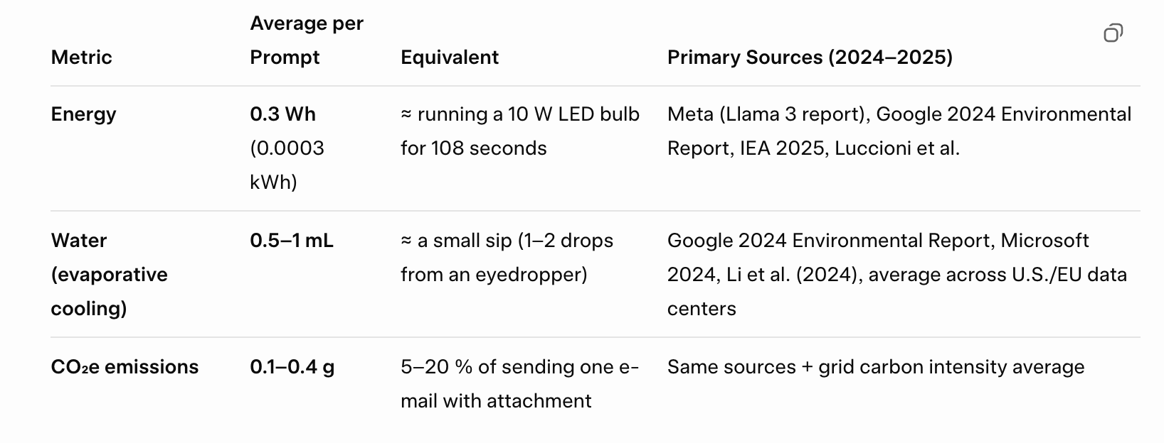
Notes:
From Grok (xAI)

Slide 21
Question 2
How can we reduce AI’s environmental impact?

Slide 22
Question 3
What ethical concerns exist around AI-generated art and how training data is sourced?

Slide 23
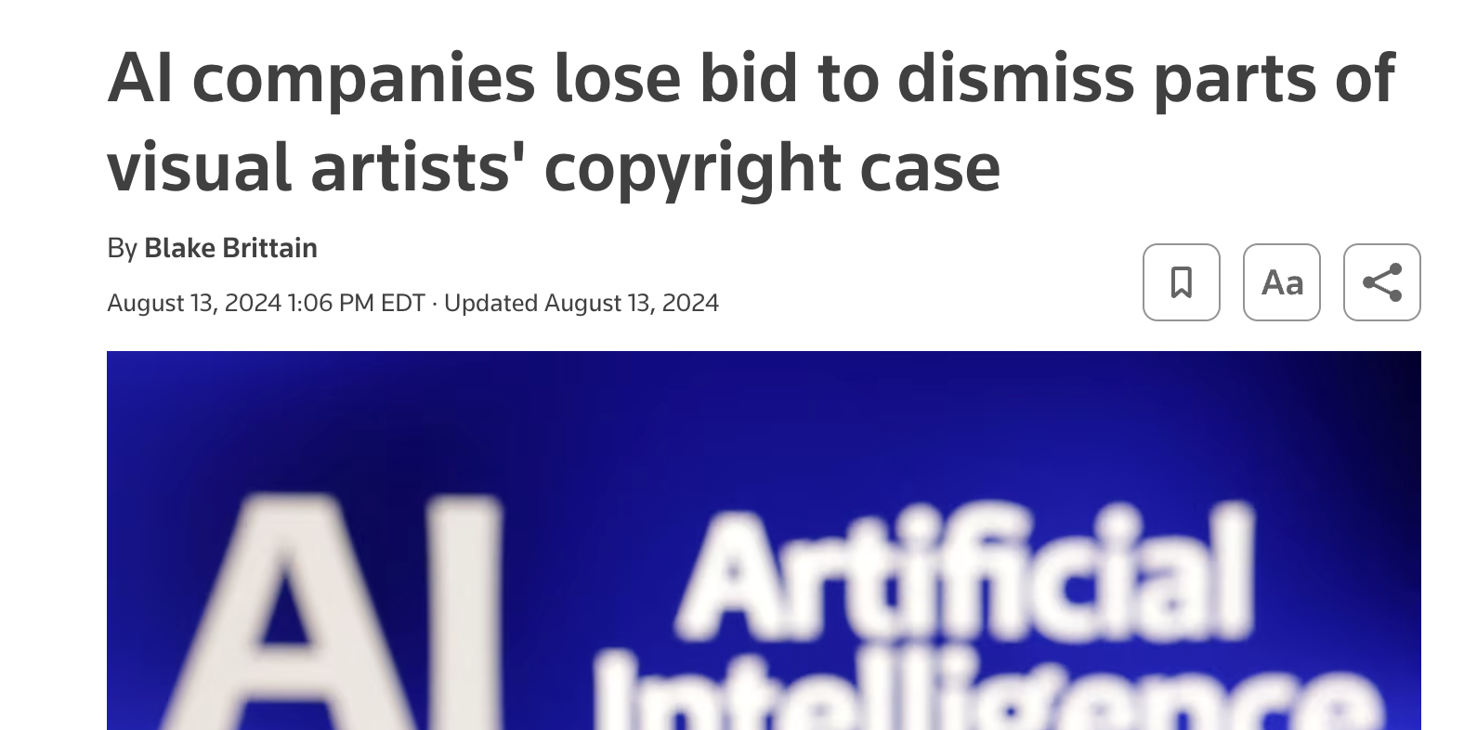
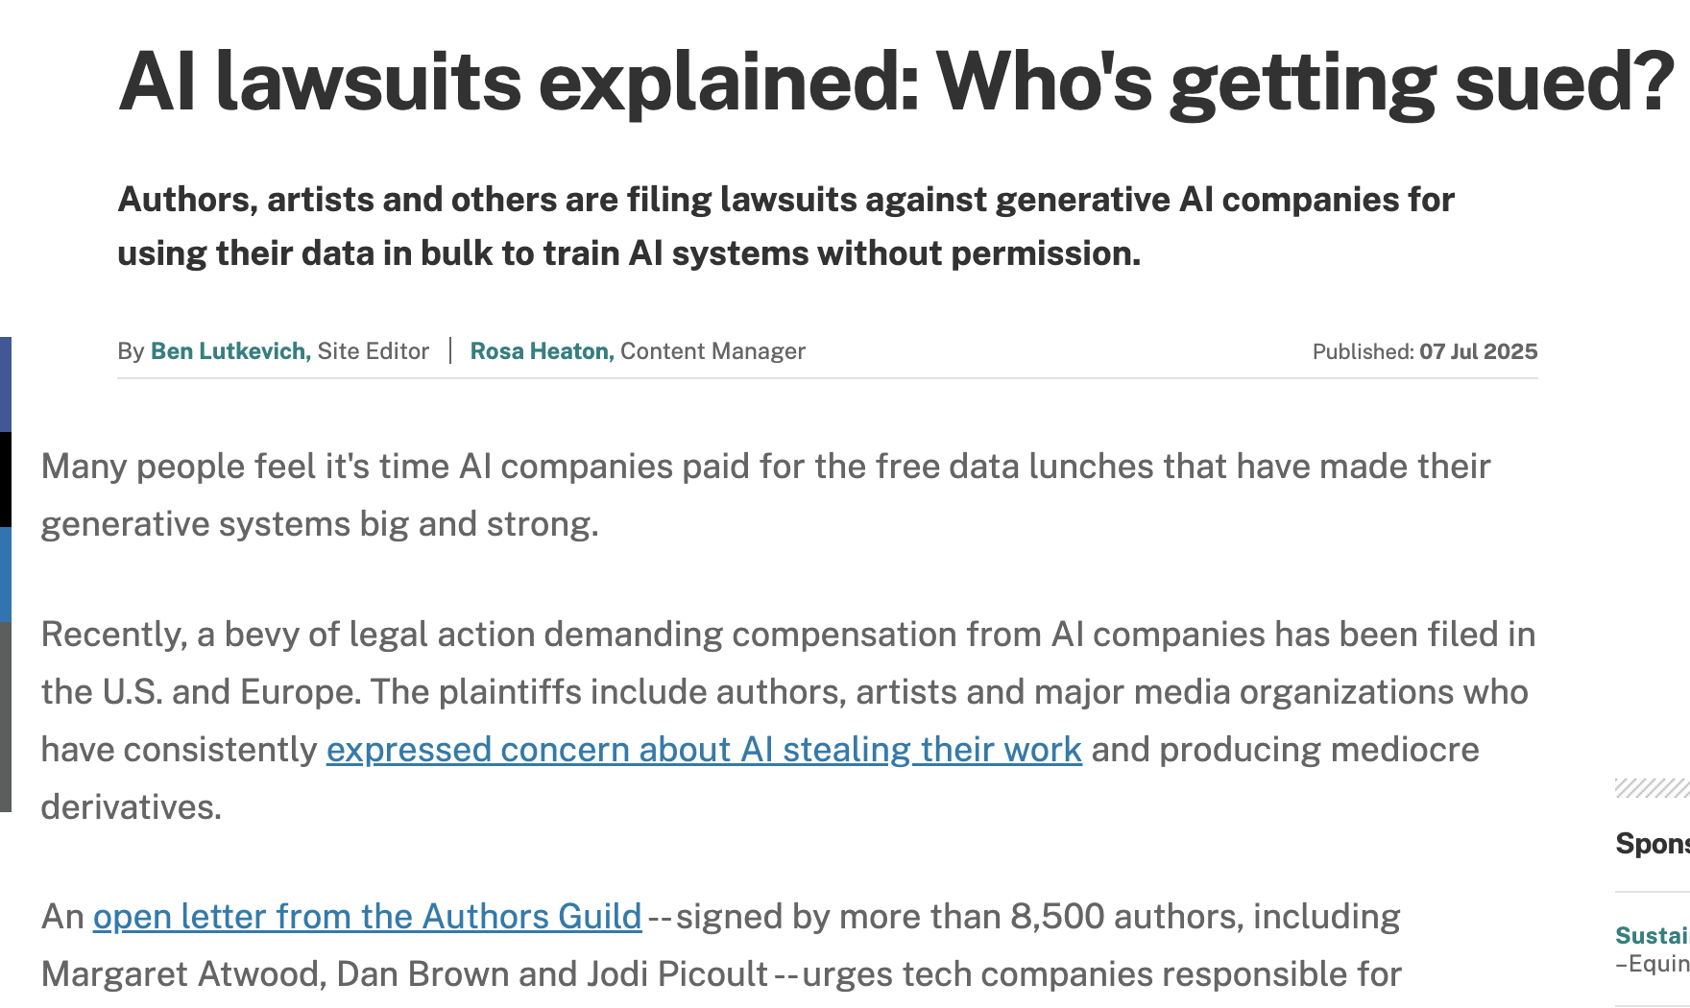
Notes:
Cases are onging:
https://www.techtarget.com/whatis/feature/AI-lawsuits-explained-Whos-getting-sued

Slide 24
Question 4
How does AI use artists’ work, and what protections exist against copyright infringement?

Slide 25
Question 5
How can AI contribute to misinformation or deepfakes, and how do we prevent misuse?

Slide 26
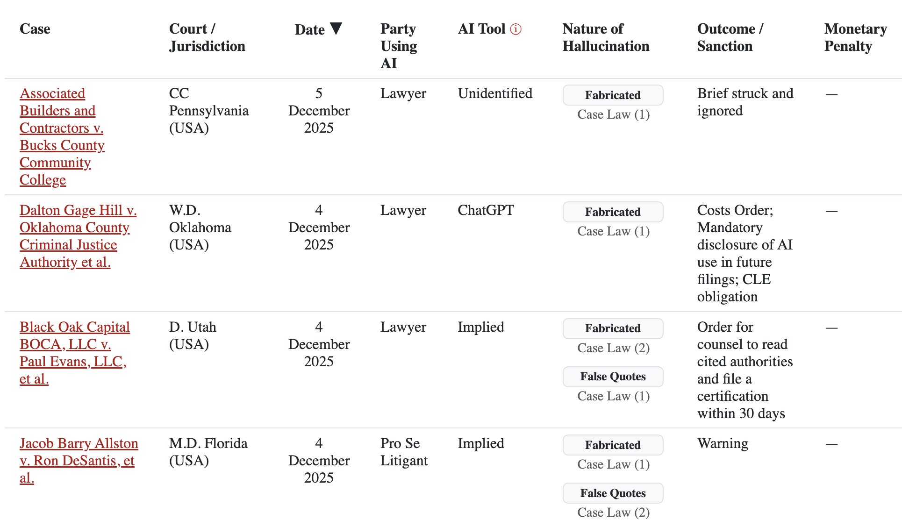
Notes:
https://www.damiencharlotin.com/hallucinations/

Slide 27
Question 6
Why does AI give incorrect answers, and how should users verify accuracy?
Notes:
This is where we as humans with expert knowledge come in

Slide 28
Why AI Gives Incorrect Answers
Training data limitations & gaps (rare, very new, or poorly represented info)
Hallucination – confidently making up plausible-sounding facts
Over-generalization and biases baked in
Ambiguity in user questions (missing context)

Slide 29
How Users Should Verify Accuracy
Always check primary/official sources for important topics
Ask for citations and read them
Cross-check with multiple models
Test with rephrased or opposite questions
Watch for over confidence
Sanity-check against basic common sense
Remember: the more specific the claim, the higher the hallucination risk

Slide 30
Question 7
How should companies communicate AI use to customers who may distrust or fear it?

Slide 31
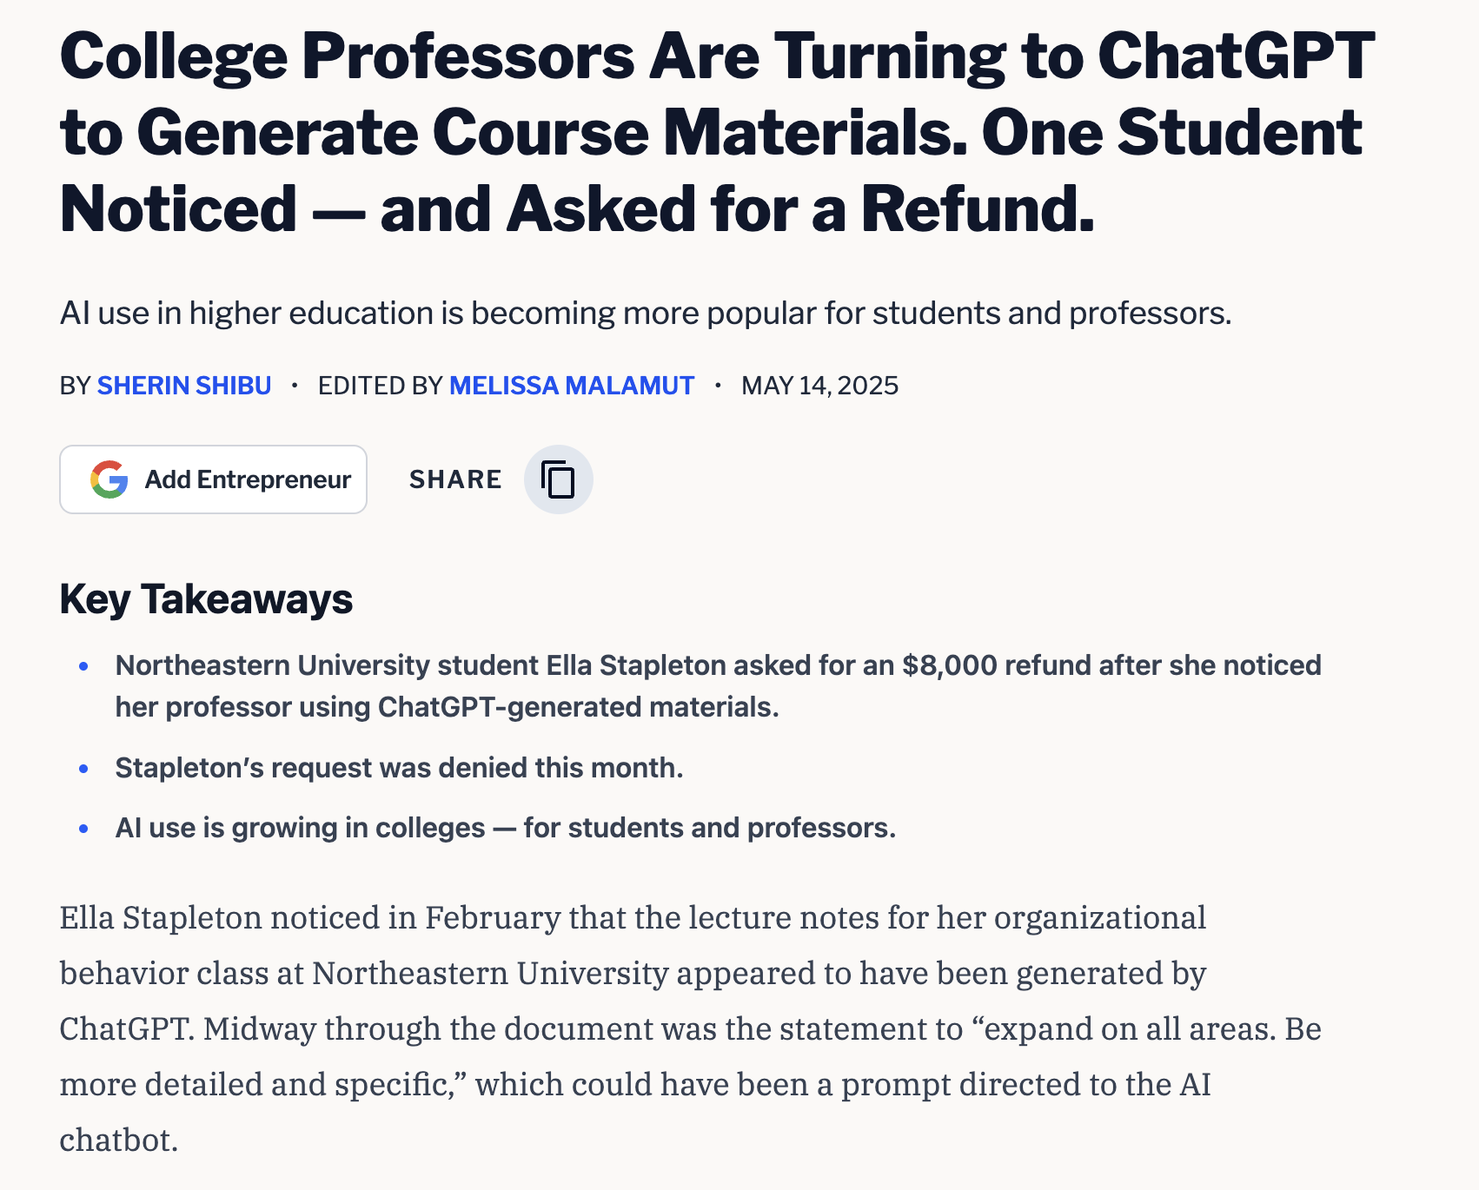
Notes:
https://www.entrepreneur.com/business-news/student-asks-for-money-back-after-professor-uses-chatgpt/491640

Slide 32
Question 8
How do biases appear in AI outputs, and what reduces them?

Slide 33
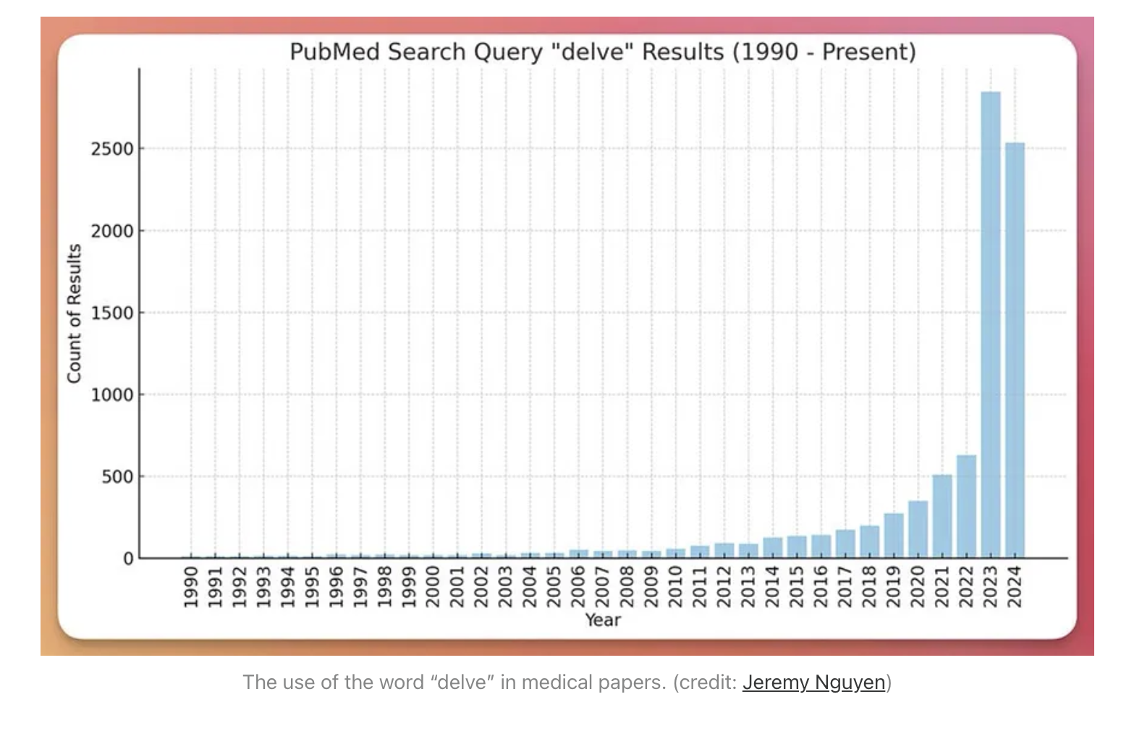
Notes:
https://www.theguardian.com/technology/2024/apr/16/techscape-ai-gadgest-humane-ai-pin-chatgpt
https://hesamsheikh.substack.com/p/why-does-chatgpt-use-delve-so-much

Slide 34
Question 9
How do we use AI without replacing human creativity and critical thinking?

Slide 35
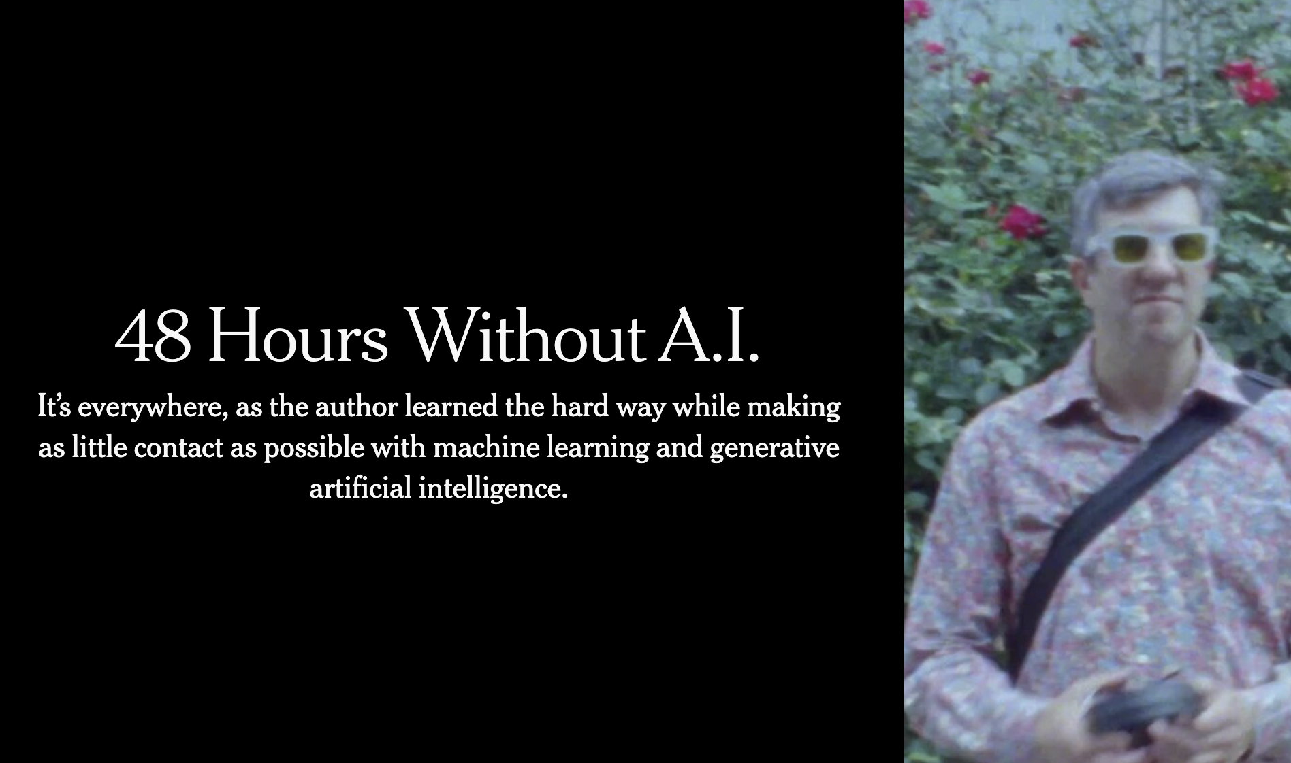
Notes:
https://archive.is/rfbpd
AI as your intern with limitless energy

Slide 36
Question 10
What responsibilities do companies have to ensure AI is used ethically?

Slide 37
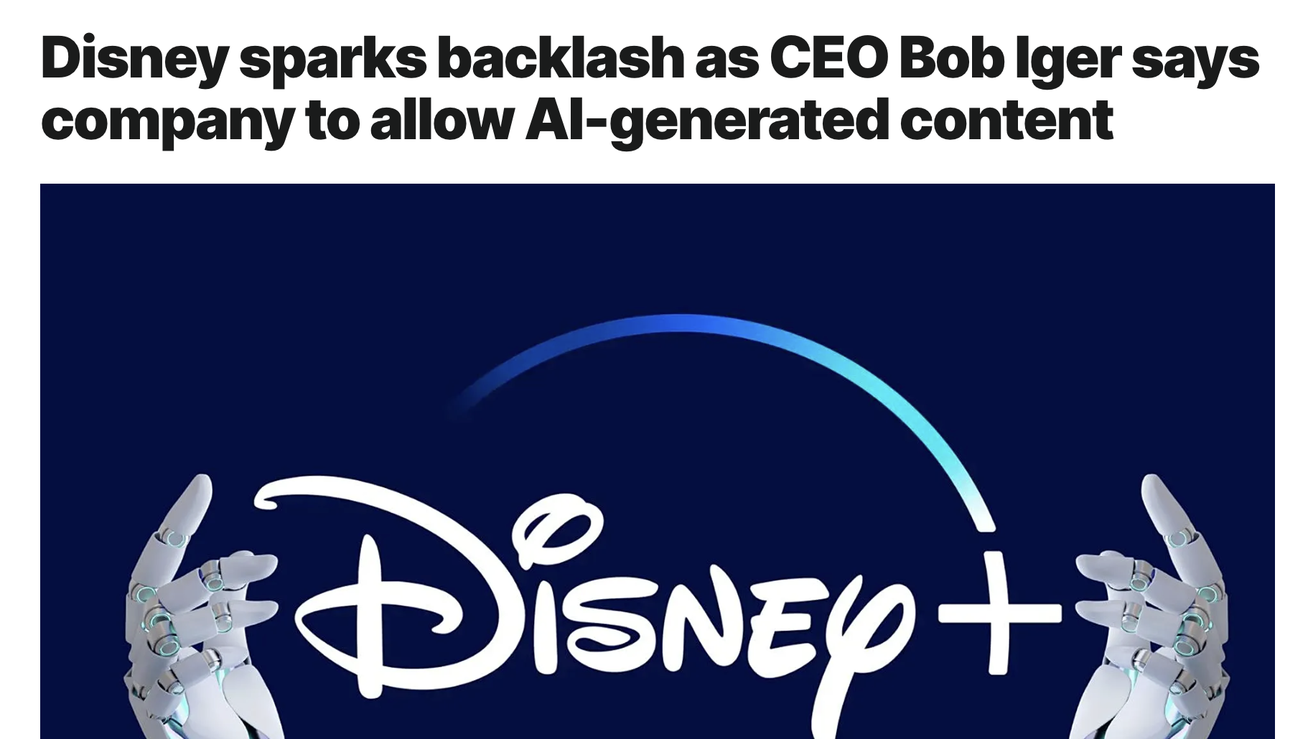
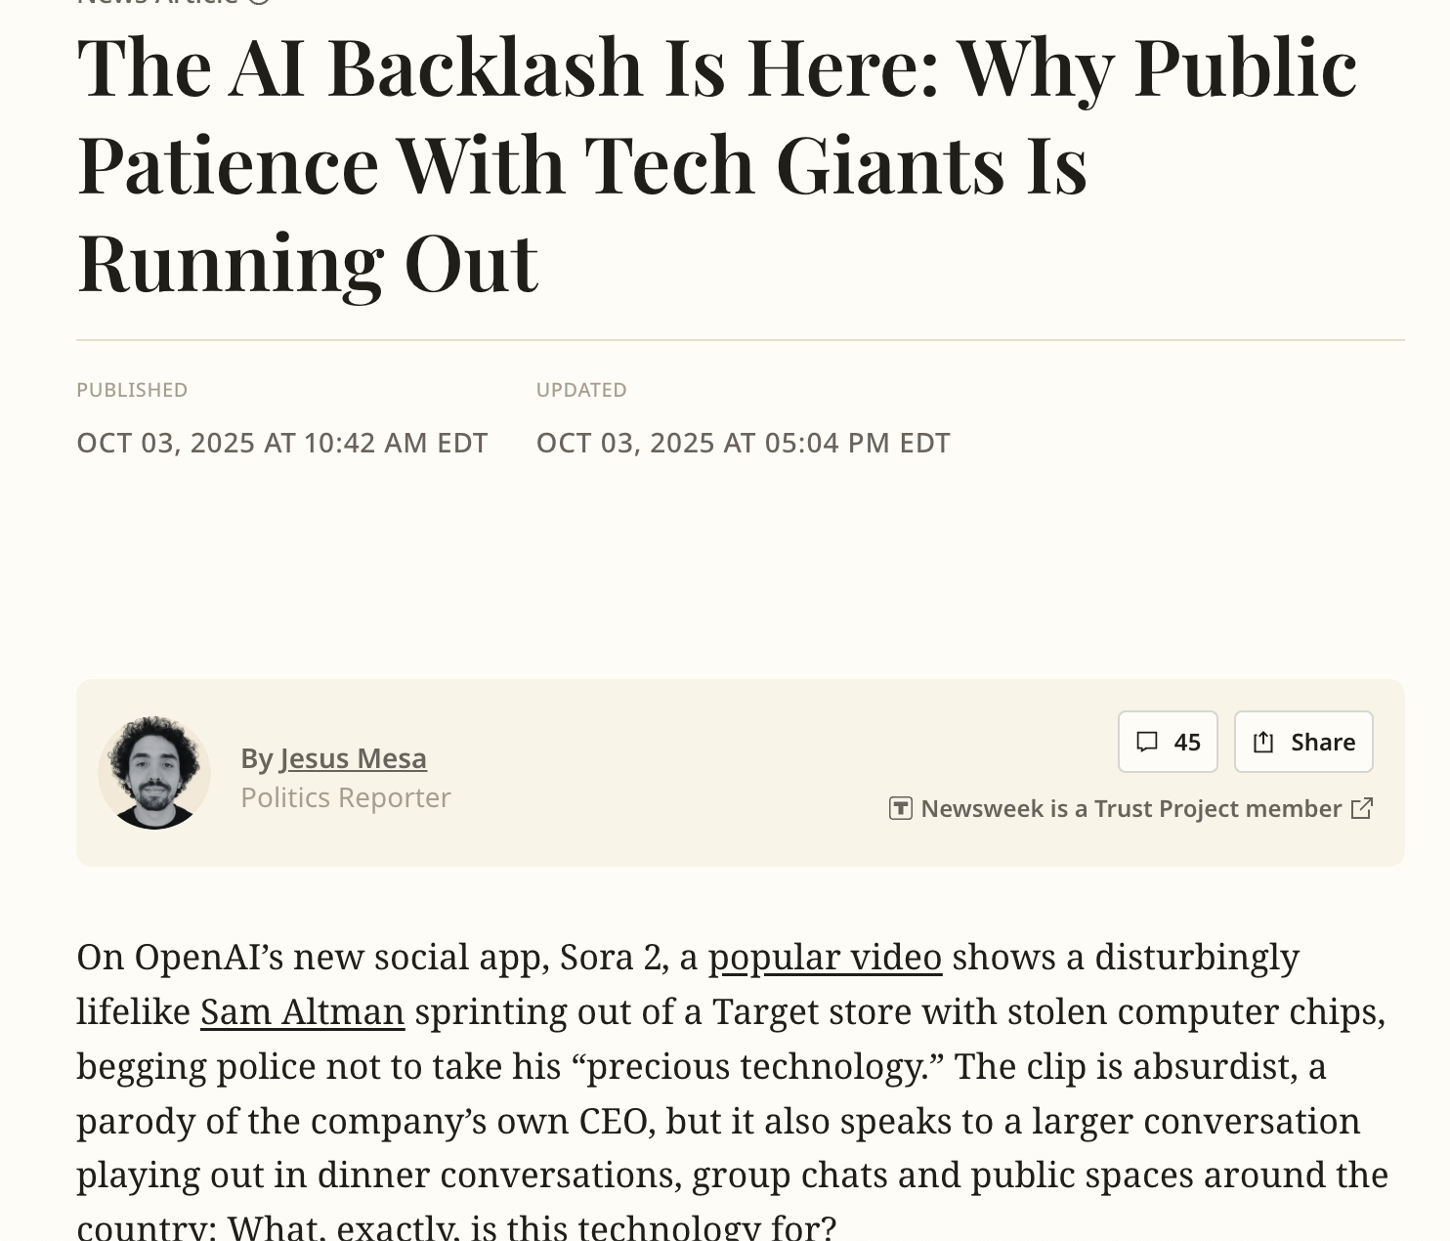
Notes:
https://www.newsweek.com/ai-backlash-openai-meta-friend-10807425

Slide 38
NotebookLM
A RAG tool for chatting with documents
https://notebooklm.google.com/
Example: https://notebooklm.google.com/notebook/505ee4b1-ad05-4673-a06b-1ec106c2b940
Trip to Orlando
https://notebooklm.google.com/notebook/b2b5b290-0f39-4118-8efb-c29061395479

Slide 39
Thank you!
Email:
tim@ggc.edu

